Slide 1
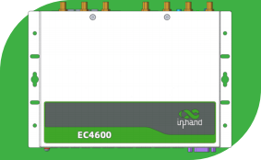
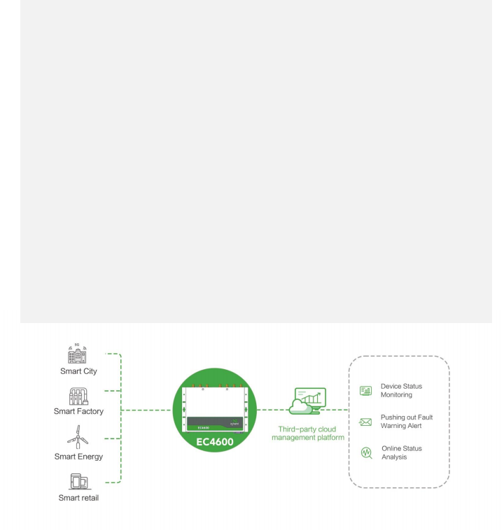


uyhand
InHand Networks
Embrace Edge AI,
Empower the era of visual recognition.
EC4600 Series AI
Edge Computer
· Strong computing capability
· 14 TOPS
· 4-way camera support
· High reliability
With the advancement of technology, there is a growing demand in the industrial and commercial sectors for real-time and efficient visual recognition. Traditional cloud-based recognition solutions are no longer able to meet market demands. InHand offers the EC4600AI edge computer, providing powerful computing
capabilities and stable performance. It helps customers process large amounts of image data locally and achieve efficient real-time decision-making, offering customers more intelligent and secure solutions.
Smart Energy
Focusing on energy efficiency and sustainable development
Smart City
Improving urban management and public services
Smart Manufacturing
Real-time monitoring and
controlling
Smart Business
Focusing on AI visual recognition
solutions
Smart Health Care
Improving medical services
and patient health management
Public Utility
Improving the efficiency
and convenience of public services
Solution

Slide 2

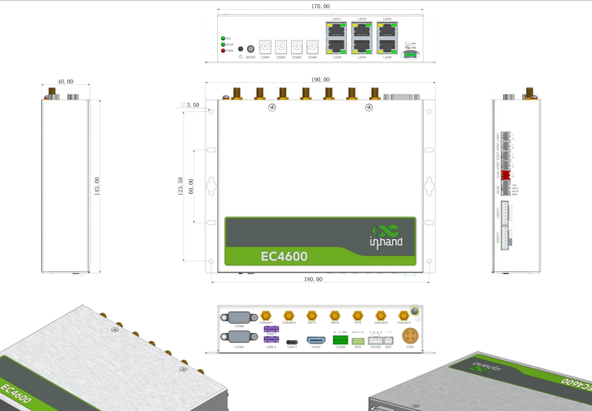
Feature and Advantage
EC4600 Datasheet
l Performance and Platform l Rich interfaces l Stable communication
• 4G/Wi-Fi/ Ethernet, etc
• Wired, cellular, Wi-Fi mutual backup, dual SIM failover
• Independent hardware and software watchdog
• Metal shell 、IP40
• Fanless
• CPU： Octa-core ARM processor , frequency up to2.7GHz
• GPU： Qualcomm® AdrenoTM
643 @ 812 MHz
• Comprehensive computing power 14TOPS
• 6x 10/100Mbps Ethernet interface
• 2x USB2.0
• 2x RS-232 and 2x RS-485
• 1x HDMI
• Backup battery interface
• SPK、LED、GPIO、NTC
Dimensions (mm)

Slide 3
Product Specifications
EC4600 Datasheet
Hardware Specifications
Software Specifications
Item | EC4600
OS
OS | Android12
Network Interconnection
Network Type | 4G
LAN Protocol | ARP, Ethernet
WAN Protocol | Static IP, DHCP
Security
Secure Boot | Support
Reliability
Backup | Dual SIM
Link Detection | Multi-Level link detection, auto-redials once disconnected
Embedded Watchdog | Device self-diagnosing, auto-recovers from operation faults
Item | EC4600
Hardware Platform
CPU | Qualcomm QCM6490 ARM Coretex technology 1 x Kryo670 Goldplus@ 2.7 GHz + 3 x Kryo670 Gold@ 2.4GHz + 4 x Kryo670 Silver@ 1.9GHz
GPU | Qualcomm® AdrenoTM643 @ 812 MHz
RAM | 8GB
FLASH | 128GB eMMC
Interfaces
EtherNet Port | 6x 10/100Mbps Ethernet port
Camera power supply | 4x white round interface, 5521, 5W
Serial Port | 2x RS-232,， DB9 2x RS-485, One is for 4-pin with power supply, and the other is for 3- pin industrial terminal;
GPIO | 2x OUT
NTC | 1x NTC temperature sensing
Wi-Fi | STA, 802.11a/b/g/n/ac/ax, 2.4G/5G dual band
USB | 2x USB2.0,
HDMI | 1x HDMI
LED | 4x LED
SPK | 1x SPK， Support 5W speakers
BAT | 1x Backup battery interface
Power Button | 1x Power
SIM Card | 2x Nano SIM Slot
Mechanical Feature
Installation | wall mounting | Protection Rating | IP40
Dimensions | 190x 143x 40mm (Including installation parts) | Housing | Metal
Power Supply
Power Input | 12V DC-input
Ambient Temperature and Humidity
Working Temperature | -10~ 60℃ | Storage Temperature | -40 ~ 85℃
Ambient Humidity | 5 ~ 95% (non-condensing)
Indicator
Power | Power supply indicator light, always on after power on;
Status | The status indicator light flashes during normal operation;
3G/4G | 3G/4Gconnection indicator light is always on when connected normally;
EMC Index
ESD | level 2;
EFT | level 2;
Surge | level 2;
Physical Features
Shock | IEC60068-2-27 | Vibration | IEC60068-2-6
Free Fall | IEC60068-2-32
Certification
irphand
InHand Networks

Slide 4

Ordering Guide
Description of selection
EC4600 Datasheet
P/N template: EC4600--<WMNN> -[X]
OS(Optional)
Base Model
Base Model
Base Model | Cellular Type &Frequency Band: <WMNN> | Memory FLASH Ethernet Port Serial Port
EC4600-DQ20-STD | China LTE CAT4 LTE-FDD: B1/B3/B5/B8 LTE-TDD: B34/B38/B39/B40/B41 WCDMA: B1/B8 TD-SCDMA: B34/B39 CDMA: BC0 GSM: 900/1800MHz | 8 GB | 128 GB | 6x 100Mbps | 2x RS232 2x RS485
EC4600-FQ58-STD | EMEA LTE CAT4 LTE-FDD: Band1/3/7/8/20/28A LTE-TDD: Band38/40/41 WCDMA:Band1/8 GSM: Band3/8 | 8 GB | 128 GB | 6x 100Mbps | 2x RS232 2x RS485
About Us
In Hand Networks is a leading IoT solutions provider founded in 2001, dedicated to driving digital transformation across industries and empowering customers to unlock their full
potential and achieve accelerated growth.
We specialize in delivering industrial-grade connectivity solutions for diverse sectors, such as enterprise networks, industrial and building IoT, digital energy, smart commerce, and mobility. Our comprehensive product portfolio and services cater to various applications worldwide,
including smart manufacturing, smart grid, intelligent transportation, smart retail, etc . With a global footprint spanning over 60 countries, we serve customers in China, the United States, France, Germany, the United Kingdom, Italy, and beyond.
File no.: IPC Version 1.0 2024 © 2 02 4 In Hand Networks. All rights reserved.
In Hand Networks reserves the right to update or modify this document at any time w ithout prior notice.
· and inHand Netw。rks
up
43671 Trade Center Place, Suite 100, Dulles, VA 20166, USA
T: +1 (703) 348-298 8
E: info@inhand.com www.inhand.com

